Slide 1
What’s New in Nesstar 4.0
Exerpts July 2012
DLI Training
University of Toronto
April 2012
Alexandra Cooper, Queen’s University
Susan Mowers, University of Ottawa

Slide 2
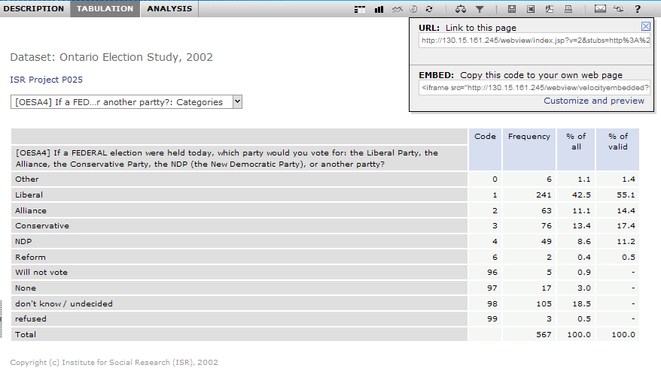
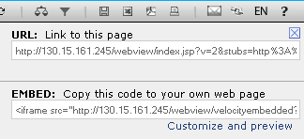
Bookmarks
create permanent links (bookmarks) to a Nesstar page
embed views/snippets (e.g. live tables, charts, or maps) in your webpages
Bookmark
Live view:
complete OR embedded view
Notes:
Live demo of linking
Customize – lets you set the border, size of the object and where on the webpage it appears (left or right)

Slide 3
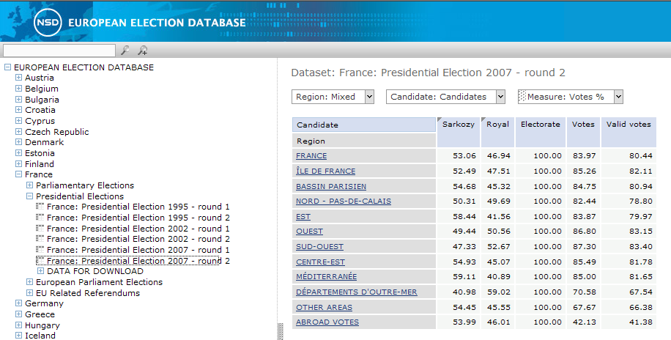
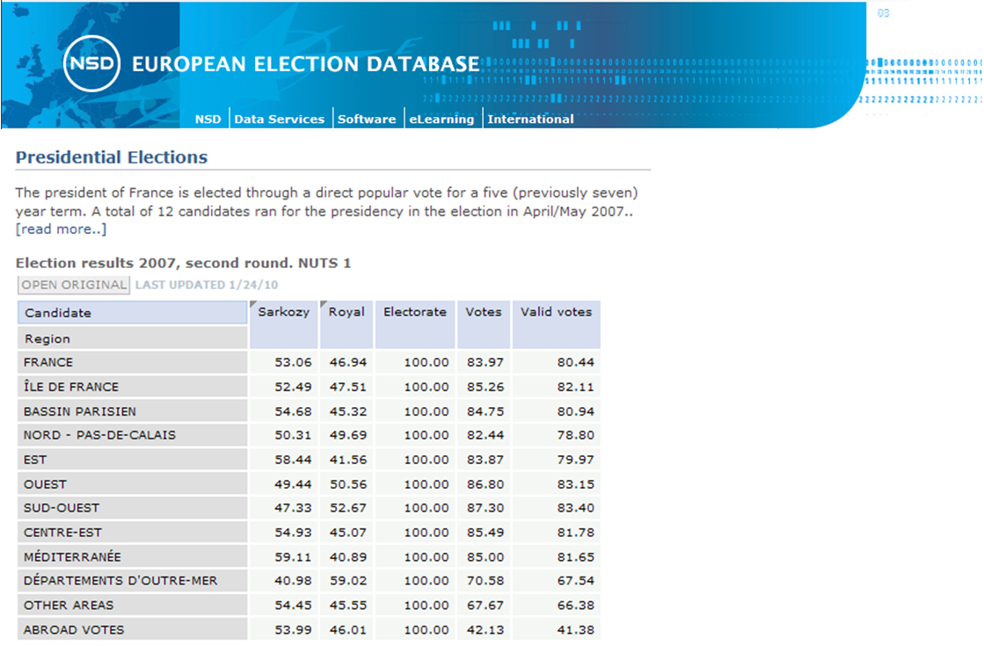
Bookmarks, example
European Election Database – table embedded in webpage

Slide 4
Toolbar
4.0
new search icons
icons and tabs are not seen until file is open
before file is open
after file is open
3.5

Slide 5
Bookmarks, example
European Election Database – table embedded in webpage

Slide 6
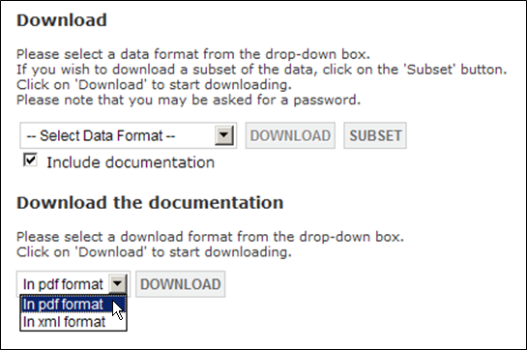
Download custom .pdf codebooks!
new download format for documentation : .pdf
.pdf replaces html*
the .pdf document comprises a user guide and codebook for the subsetted/complete variables (from the DDI)
includes cover page, hyperlinked table of contents
Notes:
Still have xml
Show GSS1 codebook

Slide 7
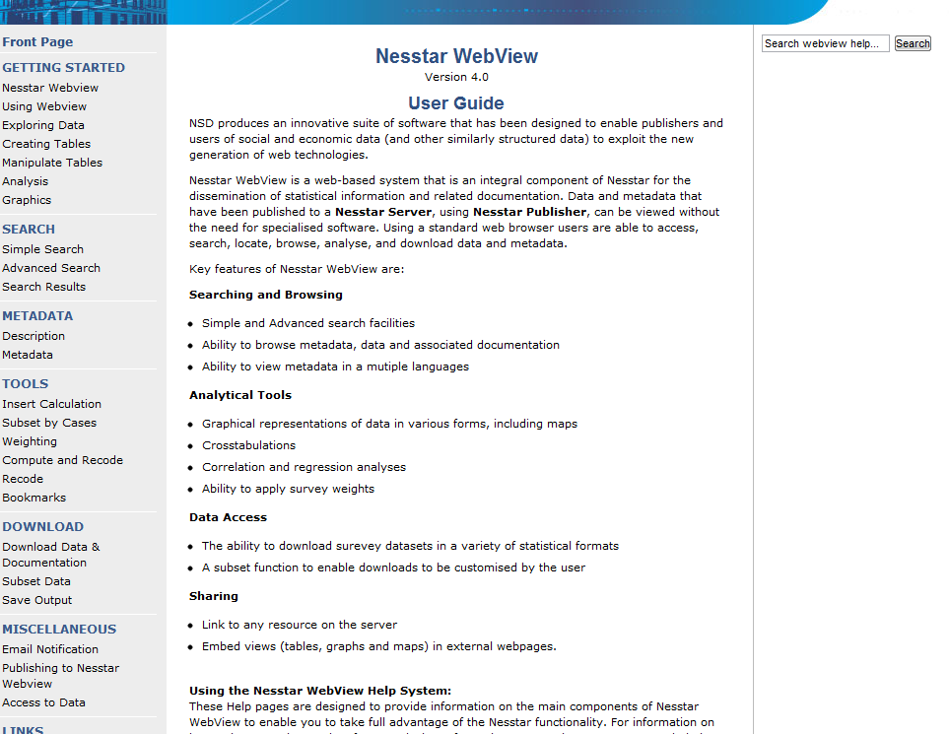
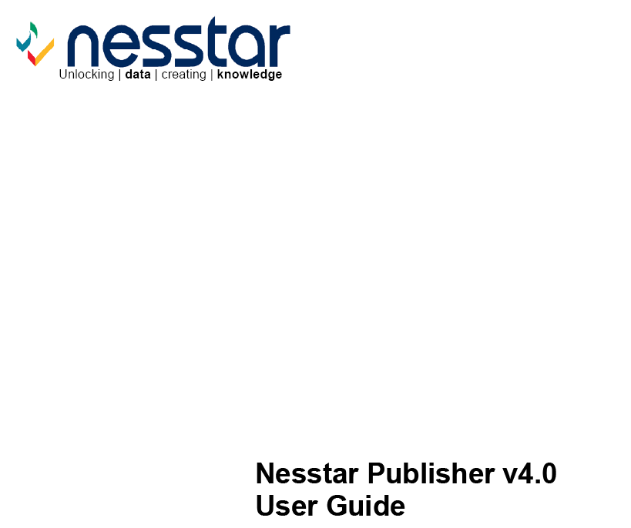
4.0 User Documentation
Webview Html User Guide
Publisher Pdf User Guide
http://www.nesstar.com/help/4.0/webview/index.html
http://www.nesstar.com/help/4.0/publisher/download_resources/Publisher_UserGuide_v4.0.pdf
Nesstar maintaining guide. Now at 109 pages (April 12, 2012)

Slide 8
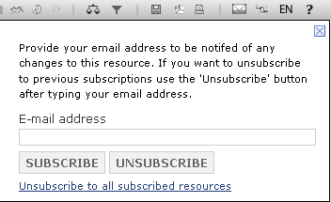
Subscribe to e-mail notification
Open a file in Webview
Click on to subscribe to e-mail notifications of changes/updates
Pop up window appears (below)
Notes:
Bookmark – takes you direct into file

Slide 9
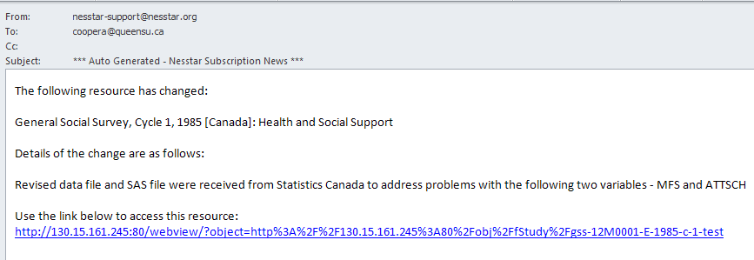
E-mail notification is received
Note the bookmark!
Notes:
Bookmark – takes you direct into file

