Slide 1
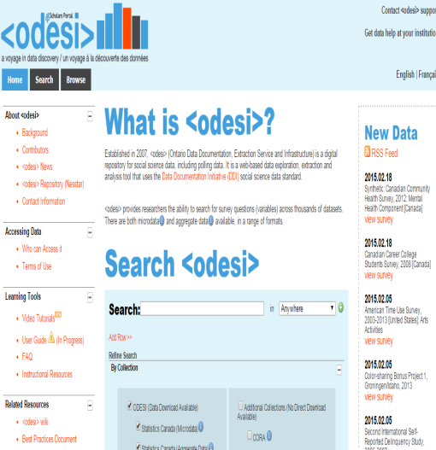
Odesi.ca (Search)
MarkLogic
Search interface
Bilingual
Metadata (more than Nesstar)
DDI*
Nesstar publisher
DDI + SPSS + Variable groupings + ftp/document
Searches non-Odesi data
Searches Odesi data
Nesstar Webserver
Browse
Analyse
Download
Nesstar Server
Data
Access
* Link

